Slide 1
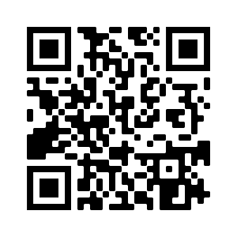
Tutorial materials and handy links
bit.ly/gw22-portals

Slide 2


Building Data Portals and Science Gateways with Globus
Lee Liming – lliming@uchicago.edu
Steve Turoscy – sturoscy@globus.org
Vas Vasiliadis – vas@uchicago.edu
GlobusWorld 2022 - May 11, 2022
Notes:
ABSTRACT SUBMITTED:
The broad scope of a typical science gateway—to simplify access to shared data, computing and other resources—makes building such a gateway from scratch a daunting task. Investigators must be able to stage data from instruments (or other sources), submit compute jobs to analyze data, move data to more persistent storage, describe data products, and provide a means for collaborators to search, discover, reuse and augment these data products. Myriad tools are available to enable all these tasks but integrating them in a way that hides the complexity from users, is a challenge.
In this tutorial we will describe an approach that bootstraps science gateway development based on the Modern Research Data Portal design pattern. The solution uses a set of open source tools that build on the established Django web framework, the ubiquitous OAuth2/OpenID connect standards for authentication/authorization, the widely deployed Globus service for research data management, and the nascent funcX functions-as-a-service platform. Attendees will learn how to rapidly deploy a science gateway that enables both automated computation at scale and data enhanced discovery of resulting data products. The emphasis will be on automating many of the required tasks so that gateway developers can focus on building differentiated, discipline-specific functionality rather than low- value—yet critical—supporting infrastructure.
We will use the ALCF Community Data Co-Op as an exemplar to illustrate how these tools have been used to support large-scale collaborative research. We will describe the overall solution architecture and introduce attendees to the individual tools. Attendees will then use these tools to deploy and configure their own science gateway to support image analysis, description, indexing and search.
The tutorial will comprise a mix of lectures, demonstration and hands-on exercises. Virtual machines will be provided for computation and for hosting the science gateway. The objective is for attendees to develop a high-level understanding of the various components and leave with working code that can serve as the starting point for their own science gateway implementation.

Slide 3

Agenda
- Hands-on exercise
- Live demonstration
Introduction and motivation
The Modern Research Data Portal design pattern
Introducing the Django Globus Portal
Deploying your Django Globus Portal
Globus data transfer: a range of options
Making data findable with Globus Search
Other customization examples

Slide 4
Introduction and Motivation

Slide 5
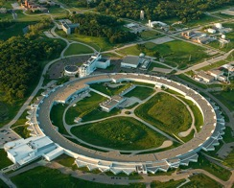



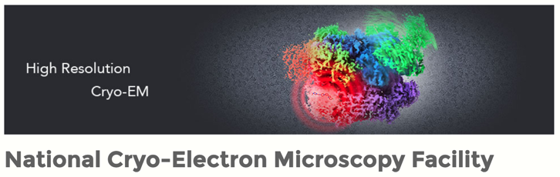

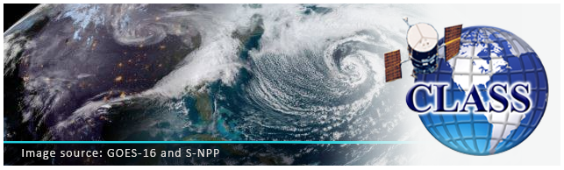

What’s the common theme?
Notes:
Sequencing Center
Move data off to shared folder
Monitor when pick up
Delete or move to archive
User facility
fast transfer speed, data can be written near real time
Sequencing centers: University cores, NIH, NCI, NYGS
Many sequencing centers rely on Globus to move data off the sequencers and then they create a shared folder that the user can access to pick up their data. The sequencing center can use Globus to monitor when the user has picked up the data and then again using Globus, delete the data or move it to archival storage.
Cryo-EM: Purdue, National Cryo-EM Facility at NCI
Beamlines: APS at ANL, ALS at Lawrence Berkeley National lab, and SLAC at Stanford.
Another type of facility, one where the user actually operates the system, such as synchrotron beam line or a Cryo- electron microscope. In that case, the fast transfer speed of globus have an extra advantage in that data can be written near real time as it comes off the instrument to the user home institutions or another remote location so that multiple people can be collaborating and analyzing data and make instrument or experiment adjustments as the experiment is running. In one case, we had a user at her home institution use visualization software available only at her home institutions to view and analyze data as it coming off the camera and then remote make camera adjustment based on the results she was seeing.

Slide 6
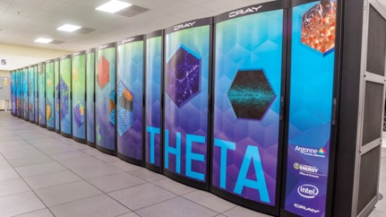
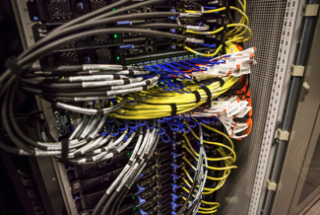
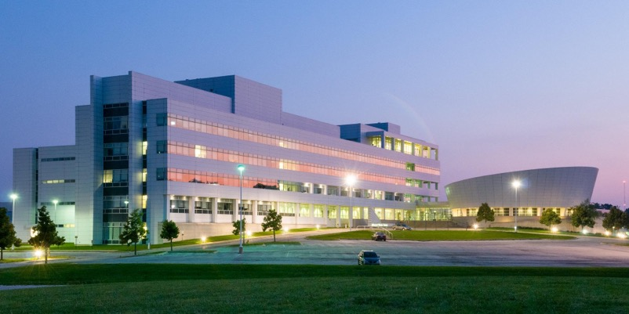
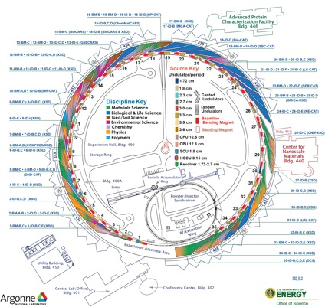

Some challenges…
Increasing data rates, heterogeneity
Continuum of computing resources
Differing workflows across instruments

Slide 7
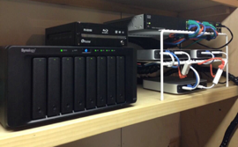
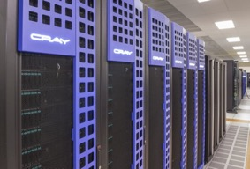
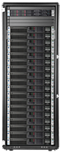



A common data flow pattern
Instrument Facility
Advanced Computing Facility
Image Analysis
Acquisition
Imaging
1
2
3
Data Portal
Distribution Store
Description/Identification
v
Search/Discovery
5
Science!
4
6

Slide 8
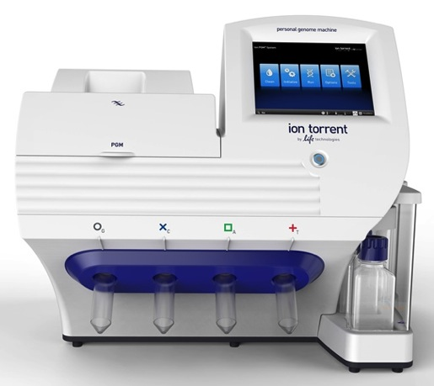

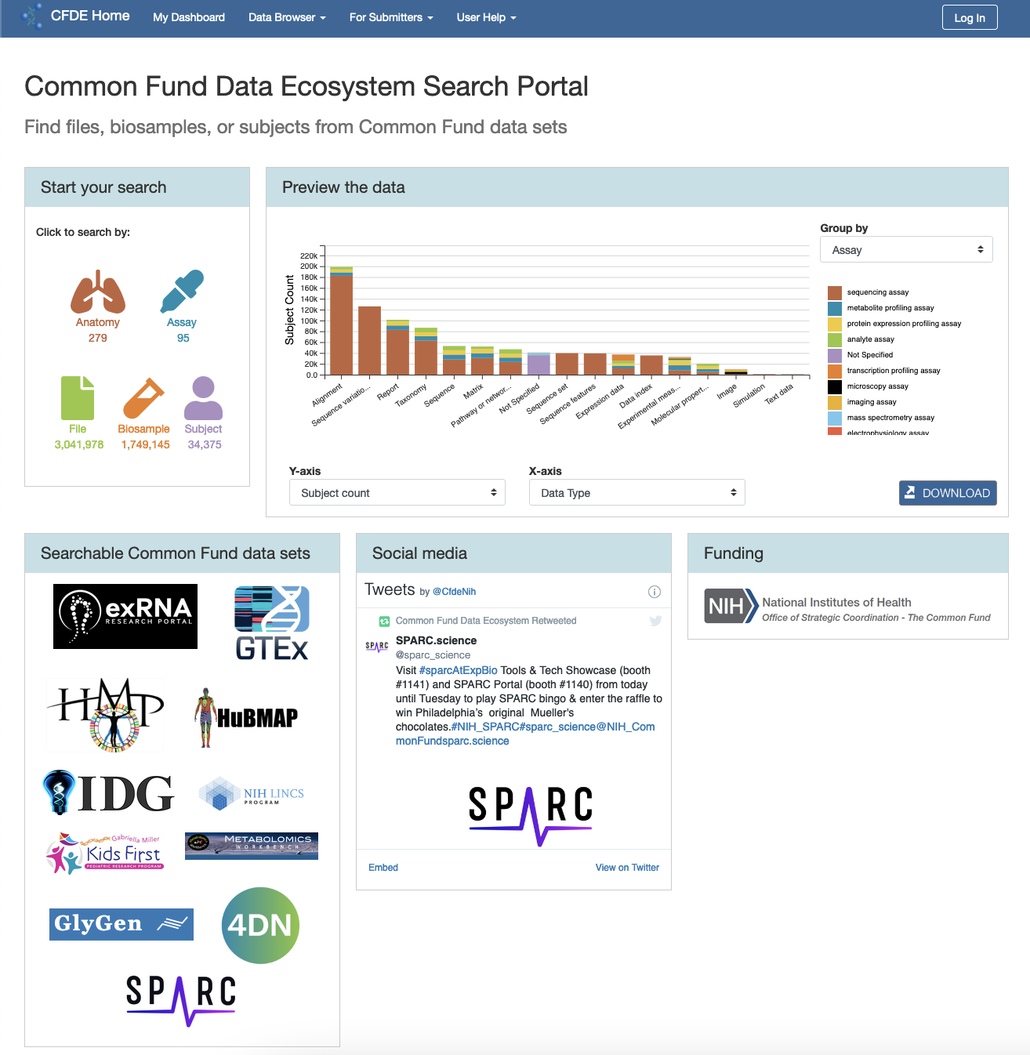


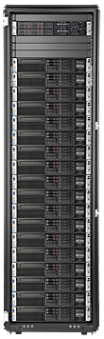


A simpler case: import “big data” into a web app
Data gathering mediated by a web application
You provide a web application (data portal, library service) that allows researchers to import “big” datasets
The datasets are too big for normal file upload interfaces or storage systems (1000+ files, TB+ data)
The datasets must be curated (authorized, reviewed & catalogued, managed)
You don’t want a lot of code maintenance, and you don’t want to give a lot of technical support to researchers
Your Cloud Storage
Example website: NIH Common Fund Data Ecosystem (CFDE) Portal
Notes:
You operate a data repository that enables researchers to deposit “big data” datasets. Your campus provides “big” storage for your use, but it doesn’t manage accounts for everyone who needs to use the repository. How can you (a) enable researchers who don’t have accounts on the campus storage to put their data there, (b) do it in an orderly, controlled manner, and (c) keep track of everything they put there?

Slide 9
Why we provide portals and science gateways
Enable a broad audience of researchers to access the latest research data
Simplify access to complicated data sources (beamlines, electron microscopes, sequencers, etc)
Add curation and cataloguing so data is findable
Enable researchers to customize their experience
Enforce (sometimes complex) access policies

Slide 10
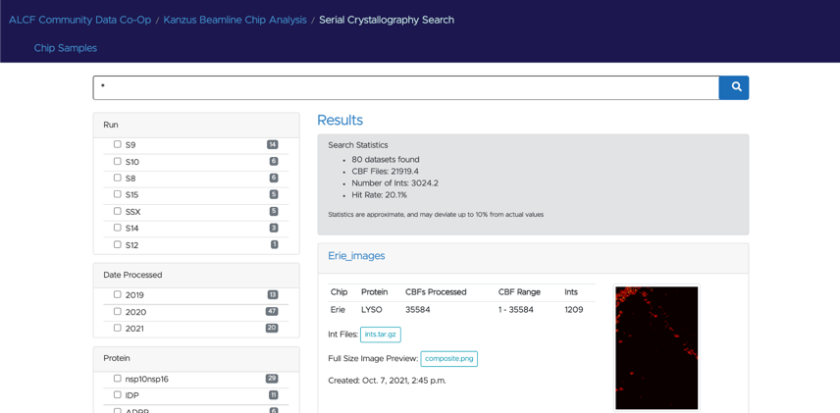
What does Globus do for portals?
Federated login
Globus handles authentication & identity federation
Your portal manages profiles
Rich groups API for access management
Public/private, group-, subject-level ACLs
Data upload/download at scale
Call out to Globus Transfer API
Facilitate discovery
Free text search in Globus Search
Filtering on specific values
User Friendly GUI
Automation
Define Flows for data handling steps (copy, move, add a search record, create a DOI, change permissions, etc.)
Run each Flow w/one API call & let Globus manage everything
Simplify your curation code
Notes:
This is why it makes sense to

Slide 11
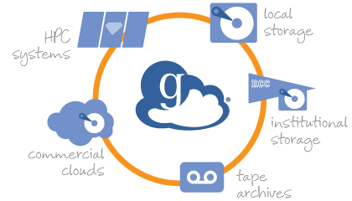
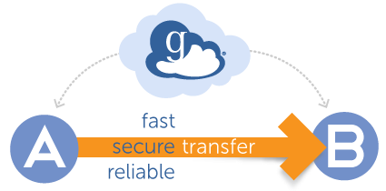
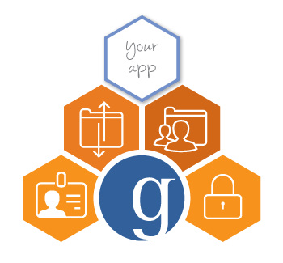
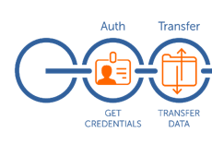
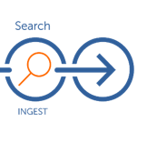
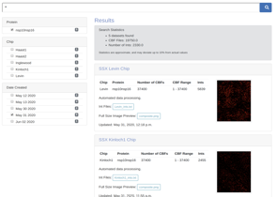


Globus services for research data management
Unified Data Access
Data Transfer and Sharing
Platform-as-a-Service
Reliable Automation
Publication & Discovery
Remote Execution (future)

Slide 12
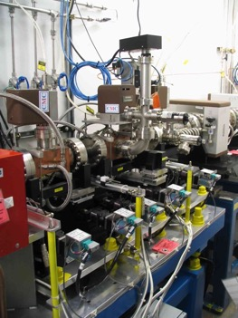
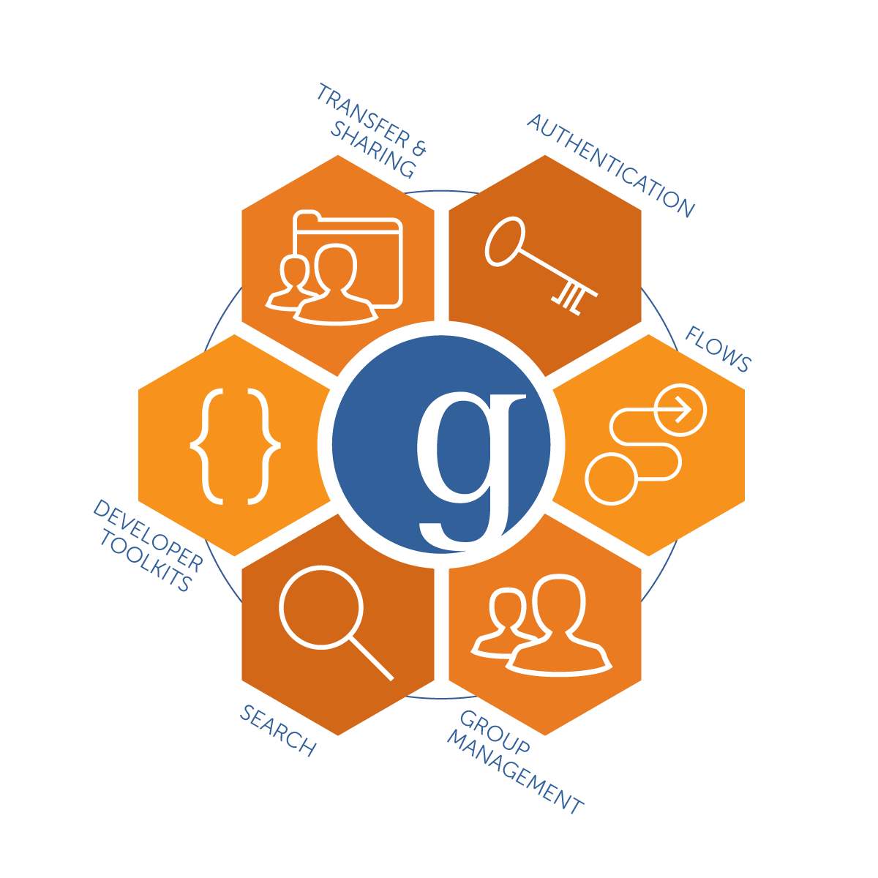
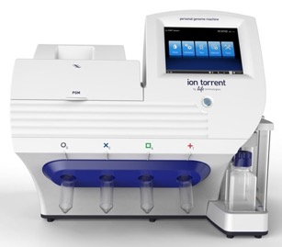
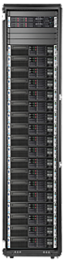
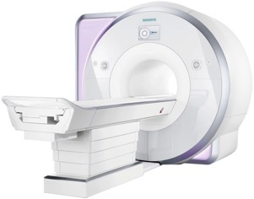
Platform services enable custom solutions
Data portals
Science Gateways
Unique workflows
Any research application…

Slide 13
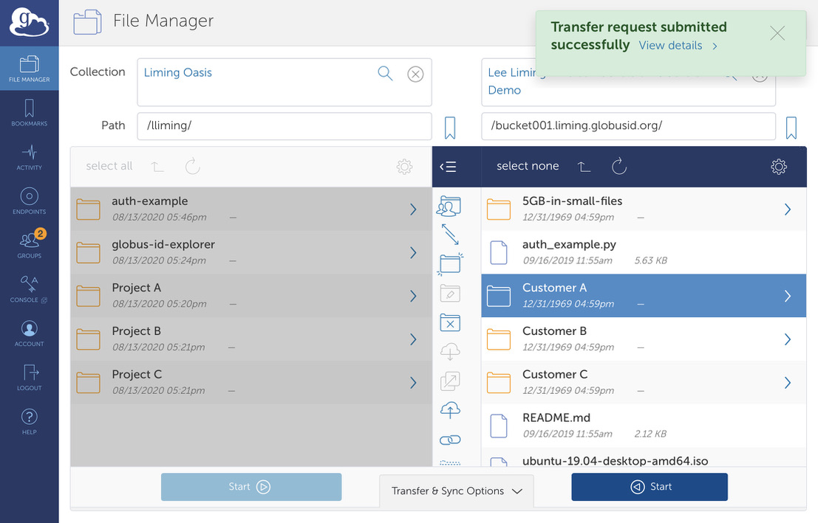
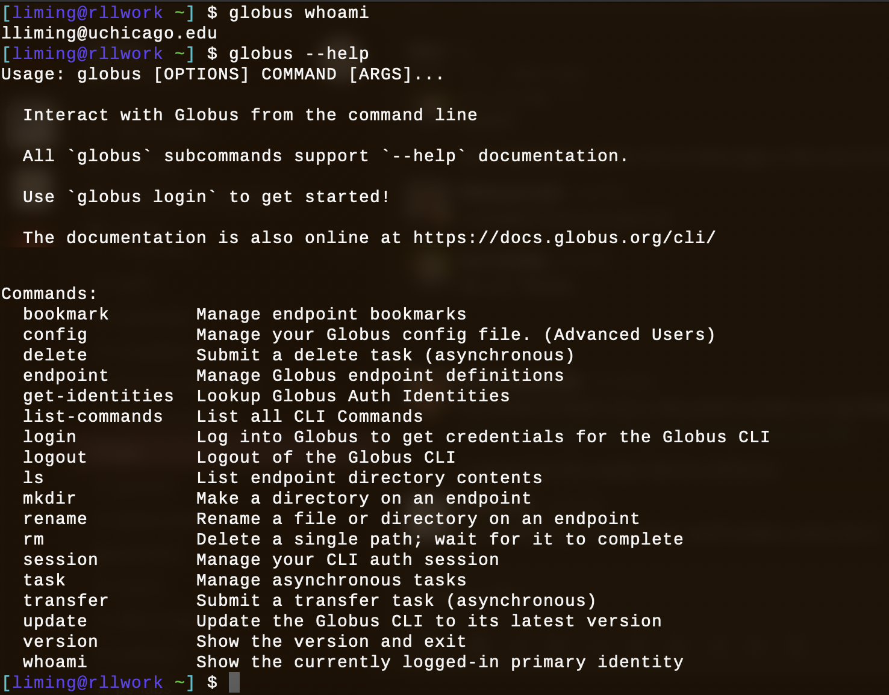
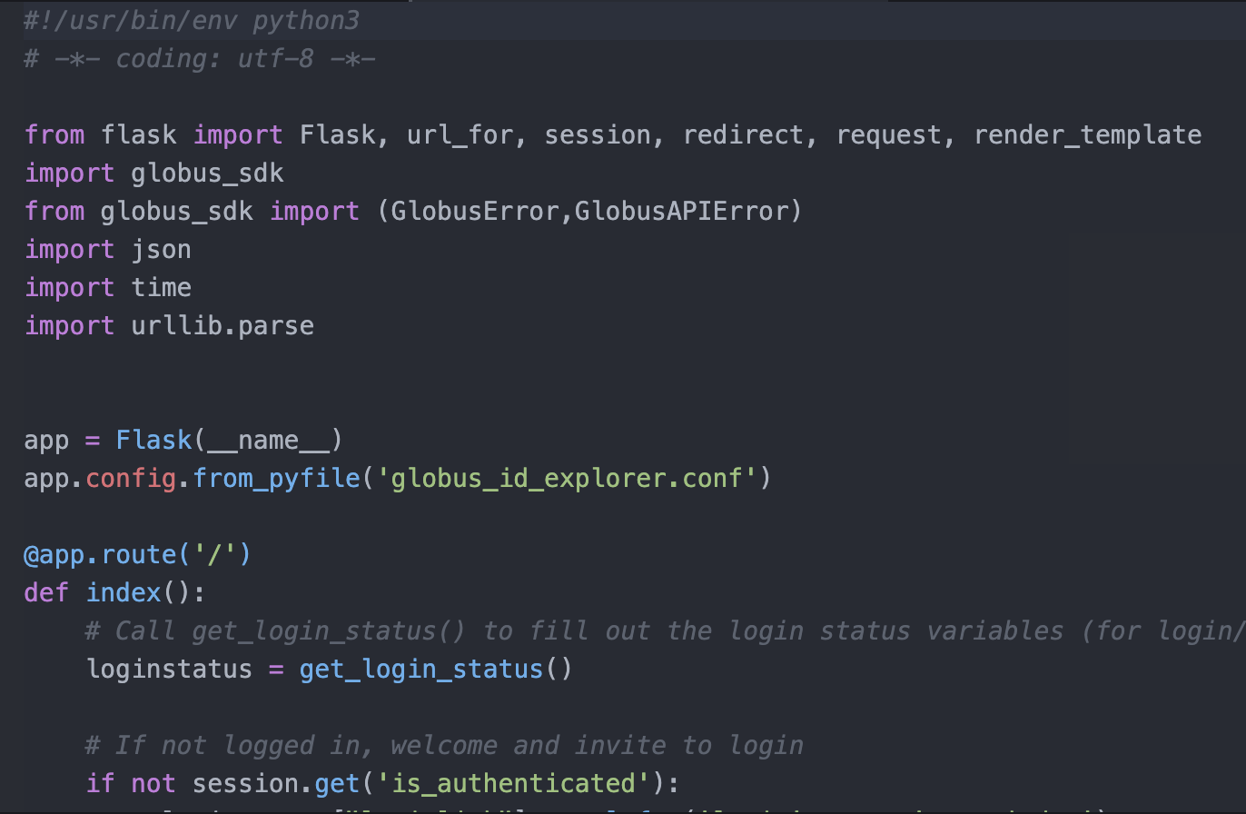
Everything can be done using our web app…
…scripted using our Python CLI…
…or built into an app with SDK & REST APIs
Web app
Python CLI
Python SDK
Globus Public REST APIs
Transfer API
Auth API
Groups API
Flows API
Search API
Notes:
NOTE: In practice, most projects mix and match these methods!
Use the SDK or CLI for things that really have to be automated/integrated with your app (e.g., logging researchers in, setting permissions, running transfers).
Use the web app for things you only do once or are OK with doing manually (e.g., creating/configuring groups, creating/configuring guest collections).

Slide 14
A whirlwind tour of Globus APIs
Globus Auth API * – authentication & identities
Globus Groups API – groups & membership
Globus Transfer API * – data transfer
Globus Search API – metadata & indexing
Globus Flows API * – automation
* covered in previous session

Slide 15
Globus Auth: Foundational IAM service
Identity & Access Management (IAM) for humans, applications, and APIs/services
Application acting as a person with person’s consent
Application acting as itself (authenticated!)
Refresh tokens for offline or long- running tasks
Authorization using linked accounts (account linking)
Authentication assurance (e.g., MFA)
Apps: web, mobile, desktop, command line clients
Services acting as clients to other services
OAuth 2.0 Authorization Framework (a.k.a. OAuth2)
OpenID Connect Core 1.0 (a.k.a. OIDC)
Notes:
Support high assurance service for use with protected data (e.g. HIPAA protected data)

Slide 16
Globus Groups: Use groups for authorization
Globus Connect Server & Transfer API use groups for guest collection permissions
Grant membership manager role to your application
Your web app can add/remove members to grant/remove access
Use groups for your application’s permissions
Instead of managing a bunch of ACLs in your application, use group membership
Lookup membership
Check membership to determine permissions
Add/remove members
Configure policy settings
Create/delete groups
Remember: you can also use the web app for any of the above!
docs.globus.org/api/groups

Slide 17
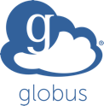
Data transfer and sharing
Move data to collection → Submit Transfer task
Make data accessible → Set guest collection access rule
Grant user/app access → Add/confirm Group membership
POST /endpoint/{endpoint_id}/access
Transfer service
POST /transfer
Groups service
GET /groups/my_groups

Slide 18
Using guest collections in your data portal
Create a guest collection; requires authentication
Cannot be completely automated – must ”log in”
Create once and automate rest of the steps
Grant the application Access Manager role
Allows the application to manage permissions on the collection
Set for application identity: appclientid@clients.auth.globus.org
Grant roles for management of endpoint and tasks

Slide 19
Globus Search - Data description and discovery
Metadata store with fine-grained visibility controls
Schema agnostic → dynamic schemas
Simple search using URL query parameters
Complex search using search request document
Search
Index
docs.globus.org/api/search

Slide 20
Distinct access policies may be applied to
Data and Metadata
…(ideally) using permissions on guest collections
…using permissions on metadata elements

Slide 21
Globus Search API overview
Ingest a new record
POST / index / id / ingest
Records include visibility field (Individual & Group IDs)
Simple query
GET / index / id / search ? q=type%3Ahdf5
Faceted search
POST / index / id / search
Posted doc includes a query string and facet specifiers
docs.globus.org/api/search

Slide 22

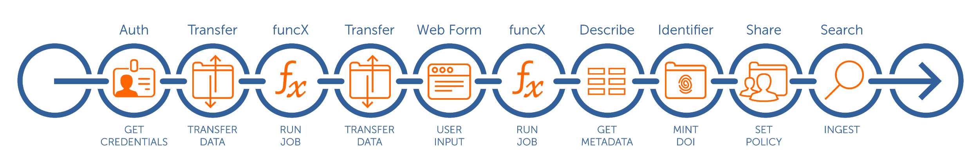
Globus Flows - Managed automation of tasks
Flows: A platform service for defining, applying, and sharing distributed research automation flows
Flows comprise Actions
Action Providers: Called by Flows to perform tasks
Triggers*: Start flows based on events
* In development

Slide 23
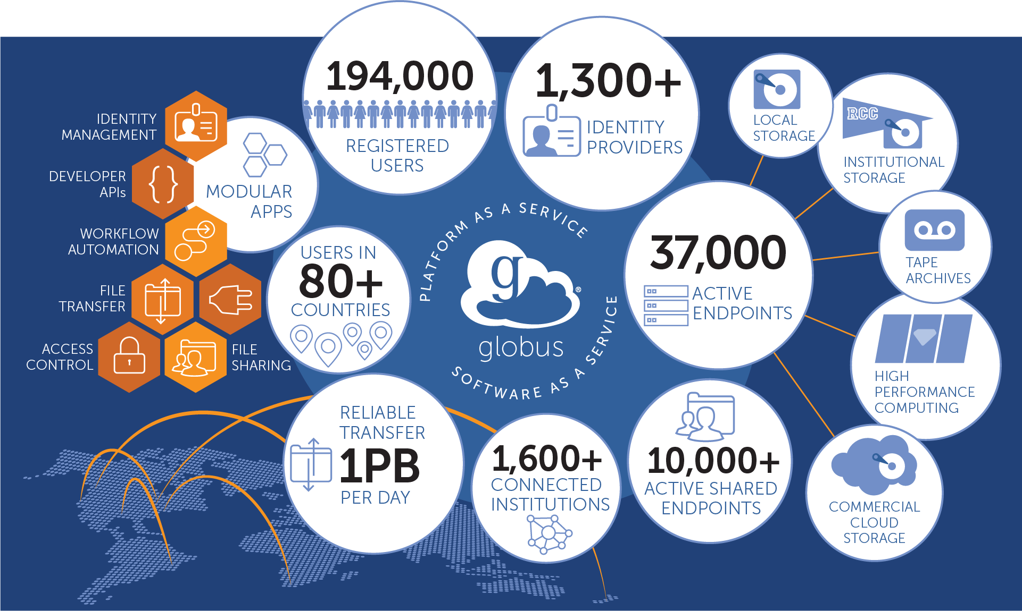

Slide 24
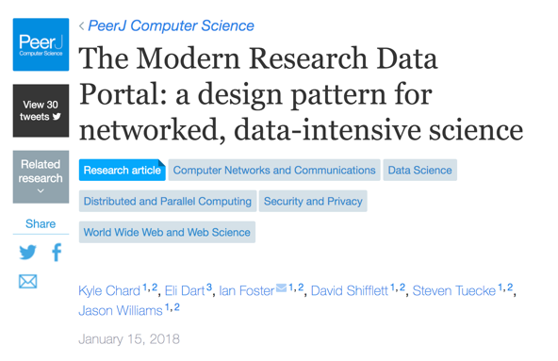
The Modern Research Data Portal Design Pattern
docs.globus.org/mrdp

Slide 25


MRDP: Key elements
Science DMZ
Fast, clean data path
Data Transfer Nodes
Purpose-built data movers
Globus Connect
Storage system enabler
Globus Platform
Secure, reliable data orchestration
Globus Portal Framework
Data discovery and access
docs.globus.org/mrdp

Slide 26
…makes your storage system a Globus endpoint

Slide 27
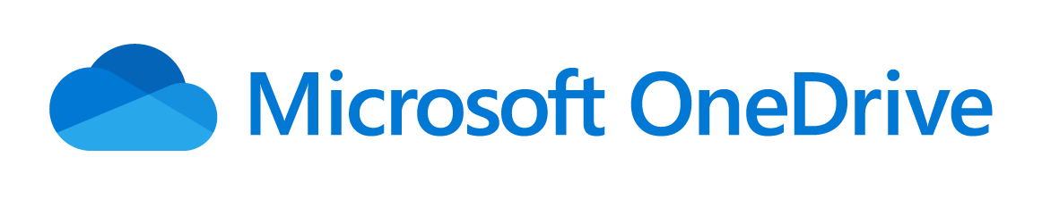
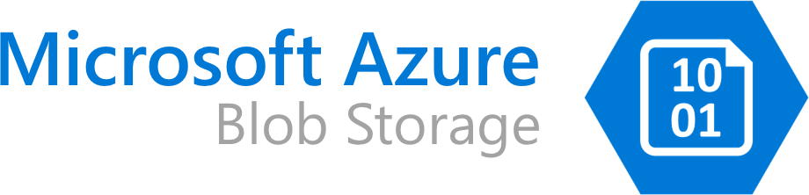

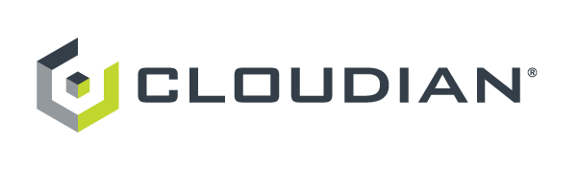
Globus Connectors support diverse systems

Slide 28
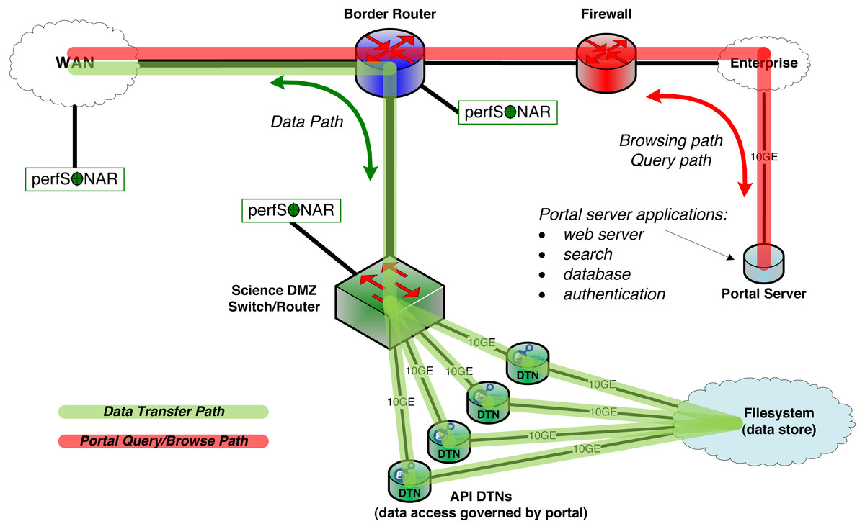
From yesterday’s Data Mobility Panel: Science DMZ network architecture
Source: ESnet Science Engagement team

Slide 29
An exemplar:
The ALCF Data Co-op
acdc.alcf.anl.gov

Slide 30


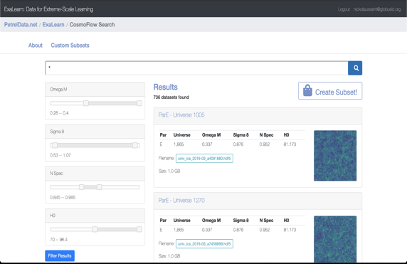


Evolving the MRDP design pattern
Input form
MRDP
Globus Search
Automated Extraction
Bulk ingest
Ingest metadata, set visibility policies
Enabling discoverability: MRDP + Faceted Search

Slide 31

Creating your data portal using the Django Globus Portal Framework
Federated login (InCommon campus IDs)
Big data export using Globus
Browse datasets w/Globus Search calls
Template-driven search results & landing pages
Django-based framework & templating
Bootstrap your project with Cookiecutter Django
Source: github.com/globus/django-globus-portal-framework
Docs: django-globus-portal-framework.readthedocs.io/en/stable/

Slide 32
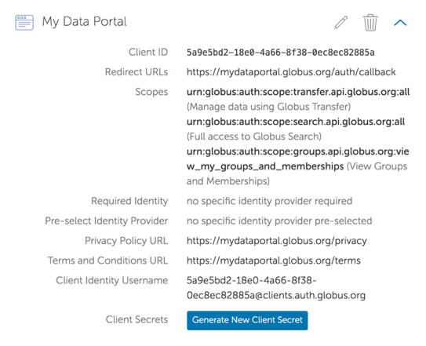
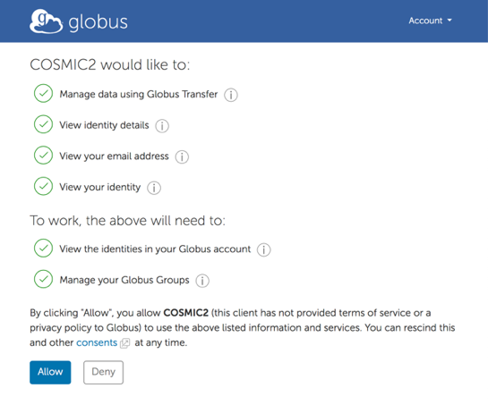
Step 0: Application registration
Set redirect URLs
Get client ID and secret
Consents implement least privileges principle
developers.globus.org
Redirect URLs
https://tutN.globusdemo.org:8443/
https://tutN.globusdemo.org:8443/complete/globus/

Slide 33
Accessing your VM
Host: tutN.globusdemo.org
Login user: devN
Password: Globus_2022#
bit.ly/minisgci-2022
Source: github.com/globus/django-globus-portal-framework
Docs: django-globus-portal-framework.readthedocs.io/en/stable/

Slide 34
Portal deployment
Install dependent libraries
For production use, add robust WSGI/ASGI server
Deploy a portal instance using cookiecutter
Configure settings
Run and use!
Future: containers

Slide 35
Exporting data via Globus from easy to custom

Slide 36
Where’s the data?
Remember – we’re using Globus Connect, so your datasets are in a Globus collection
Three options for enabling transfers from your portal:
Link to the collection in the Globus web app (Easy! But not customizable.)
Use the Globus Helper Page (Easy! A bit customizable.)
Use a JavaScript interface (Less easy. Very customizable.)
Let’s see an example of each…

Slide 37
Easy: Link to the Globus web app

Slide 38
Easy: Select destination with Globus Helper Page

Slide 39
Advanced: Create a custom UI that uses Globus SDK

Slide 40
Adding a new search index to your portal

Slide 41
Other Customizations with Django Globus Portal

Slide 42
Add image previews to search results

Slide 43
Use sliders for search facets

Slide 44
bit.ly/minisgci-2022 docs.globus.org github.com/globus outreach@globus.org support@globus.org

